Slide 1
FUTURE IS COMING
Turret Agent
Team DeadlineWarriors
2022/07/27

Slide 2


01
Feedback

Slide 3


Feedback
Bug:
No severe bugs in beta
Issues:
Weapons imbalance
Keep shooting a static boss for a long time is boring
Level 2 is too difficult

Slide 4
02
Improvement

Slide 5

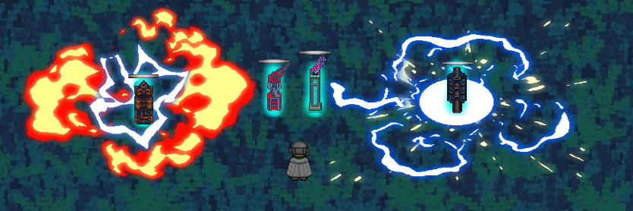
Turrets
All kinds of turrets are available:

Slide 6
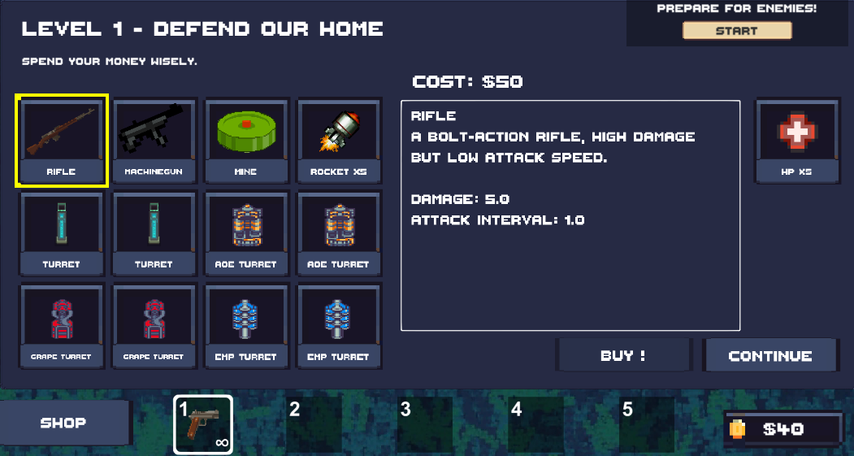
Economy
New shop UI and prices are balanced:

Slide 7
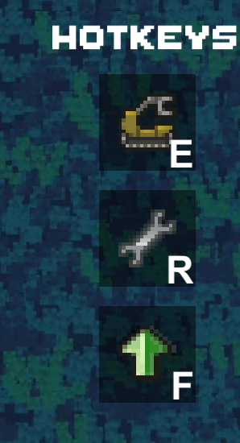
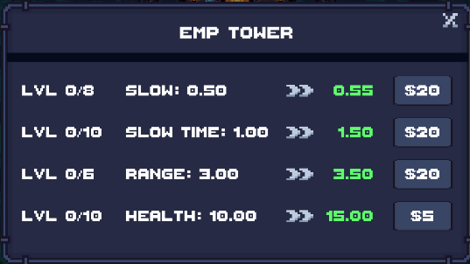
UI
Upgrades:
UI:

Slide 8
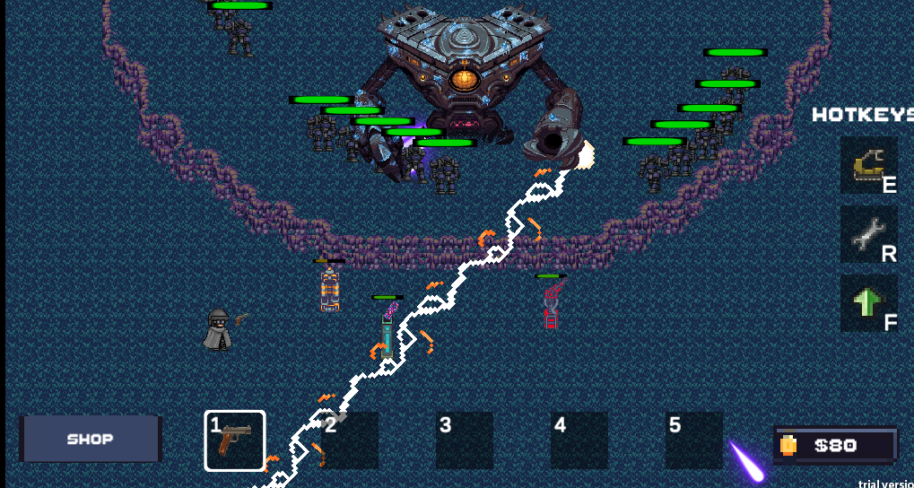
Boss fighting:

Slide 9
Attention!
Remember to use R/E/F !

Slide 10
FUTURE IS COMING
Thank you for your watching
Team DeadlineWarrior
///DOCER///

